Slide 1



Boom Bikes
Linear Regression Case Study

Slide 2
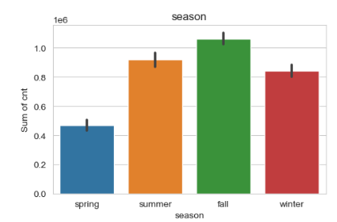
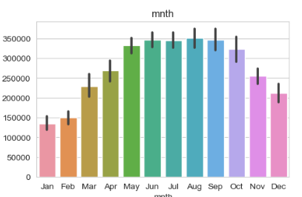
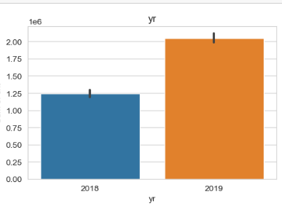
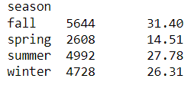
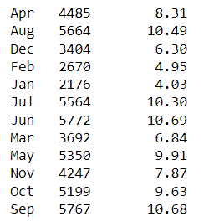

Assignment-based Subjective Questions
1. From your analysis of the categorical variables from the dataset, what could you infer about their effect on the dependent variable? (3 marks)
Here is the inference about the effect of categorical columns on the dependent variable :
Max Rides are from the fall Season
Rides have increased year on year
Rides growth visible till June and after that it started declining,
Peak are between May to Sep.

Slide 3
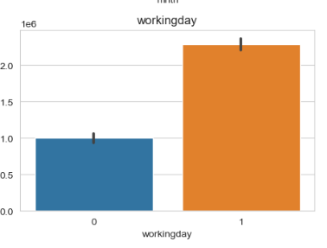
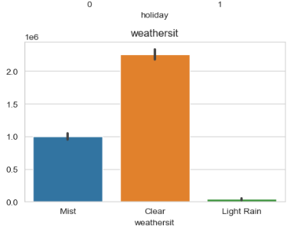
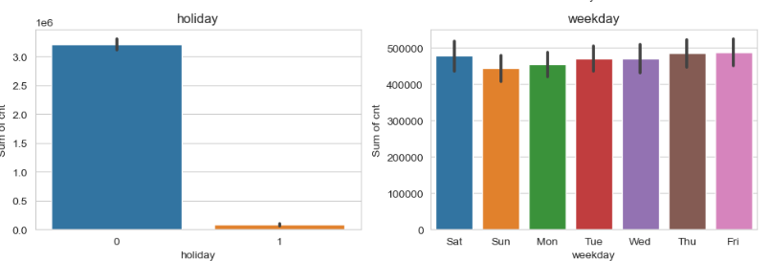
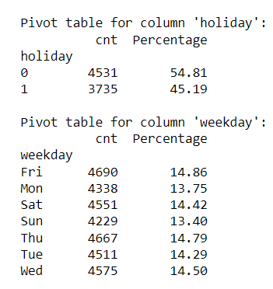

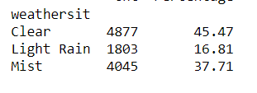
Assignment-based Subjective Questions
No Major Impact on holiday and weekday
Working days have higher ride counts
Clear Weather Situation have higher Rides

Slide 4
Assignment-based Subjective Questions
2. Why is it important to use drop_first=True during dummy variable creation?
When we apply dummy variable technique to a variable , it basically convert all the characters to True/ False (Abbreviated as 0,1 ). If value of a row is true that means the other variable can be considered as false itself. Having that column will add an extra space which can be very well interpreted even without its presence , so it drops the first column.
For Example : Lets say we have a column as Weather condition which has three distinct values : clear , light rain , ,mist. The same will be represented as below :
Clear | Light Rain | Mist | Represents
0 | 1 | 0 | Light Rain
0 | 0 | 1 | Mist
1 | 0 | 0 | Clear
Light Rain | Mist | Represents
1 | 0 | Light Rain
0 | 1 | Mist
0 | 0 | Clear
Same can be
Achieved With
Just 2 Columns

Slide 5
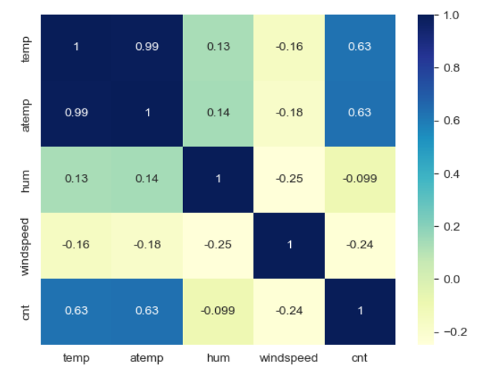
Assignment-based Subjective Questions
3. Looking at the pair-plot among the numerical variables, which one has the highest correlation with the target variable?
Temp and Atemp variable have the
Highest correlation with the target variable

Slide 6
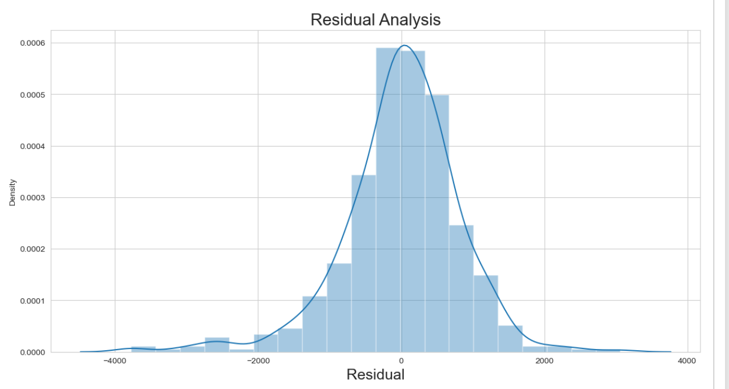
Assignment-based Subjective Questions
4. How did you validate the assumptions of Linear Regression after building the model on the training set?
In linear regression, the assumption of normally distributed residuals is crucial for valid hypothesis testing, confidence intervals, and model inference. In our case , we calculated the residual error , By plotting it , we found it to be normally distributed

Slide 7
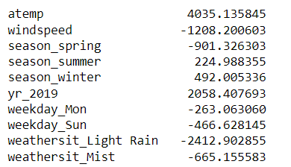
Assignment-based Subjective Questions
5. Based on the final model, which are the top 3 features contributing significantly towards explaining the demand of the shared bikes?
The top 3 Features that contribute significantly are :
Atemp – High Ride as Feeling Temperature rises
Yr_2019 – High Count of Rides As the year increase
Weathersit_Light Rain – Low Rides With Light Rain

Slide 8
General Subjective Questions
1. Explain the linear regression algorithm in detail.
Linear regression is a supervised machine learning algorithm used to predict a continuous numerical outcome based on one or more input features. It assumes that there is a straight-line relationship between the input variables and the target variable. The main objective of linear regression is to find the best line that fits the data points and minimizes the difference between the predicted and actual values of the target variable.
Linear Regression is only possible when there is a linear relation found between different variables (also referred as features) , if there is no linear relation is visible on a plotted scatter chart of different variables , the model will not work as expected and the accuracy of model will get down drastically. Linear regression assumes linearity, independence of errors, constant variance (homoscedasticity), normality of errors, and absence of multicollinearity between independent variables. These assumptions should be verified and validated.
Linear regression equation is referred as Y = β0 + β1X1 + β2 x X2 + β3 x X3 ... βn x βn where n is the number of independent variable. This equation is basically the best fit line equation that has the least distance between actual and predicted values of the target variable. While establishing , this equation and during the process of Feature selection , it is very important to make sure that the selected features for the model creation should not have multicollinearity issue between them because if they have multicollinearity , the weightage of similar feature will be taken into account making our model accuracy not as expected.
In simple linear regression, we have only one input feature (X), while in multiple linear regression, we can have multiple input features (X1, X2, X3, ...).
The linear regression model assumes that the relationship between the input features and the target variable can be represented by an equation.
For example, in simple linear regression, the equation is y = b0 + b1 * X, where b0 is the starting point (y-intercept), b1 is the slope, and X represents the input feature.
For multiple linear regression, the equation becomes y = b0 + b1 * X1 + b2 * X2 + ... + bn * Xn, where each X represents a different input feature.
During model training, we try to find the best values for the coefficients (b0, b1, b2, ..., bn) in the equation. These coefficients determine the shape and position of the line. We use an optimization algorithm, such as Ordinary Least Squares (OLS), to minimize the difference between the predicted and actual values of the target variable.
After training the model, we evaluate its performance. We use evaluation metrics like Mean Squared Error (MSE), Root Mean Squared Error (RMSE), Mean Absolute Error (MAE), and R-squared to measure how well the model predicts the target variable. These metrics help us understand the accuracy of the predictions and how well the model fits the data.

Slide 9
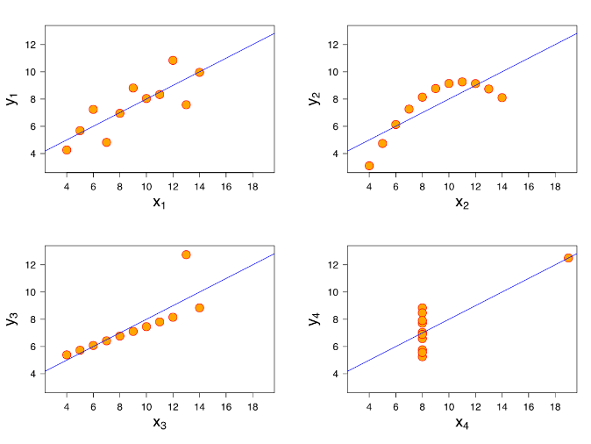
General Subjective Questions
Anscombe’s quartet explain the importance of data visualization.
In 1973, a paper was written by a statistician named Anscombe, emphasizing the importance of graphing data rather than depending solely on statistical analysis. Four sets of XY data pairs were created, Each dataset consists of 11 points with two variables: x and y , which are nearly identical in simple descriptive statistics. It was demonstrated that graphical representation plays a crucial role in comprehending and interpreting data effectively, as shown by Anscombe's work.
2. Explain the Anscombe’s quartet in detail.
While choosing linear regression model , one needs to take special attention in identifying outliers and before selection , its extremely important to plot the data and get insights of it as to how data is being drawn and whether it is actually showing linearity or not. Like, in the above graphs plotted , if we look at it , the data plotted has identical summary statistics (such as mean, variance, correlation) but the datasets have different distributions and relationships between the variables.
In Summary Anscombe’s quartet emphasizes to do exploratory data analysis before finalizing the model selection. It also makes us understand how outliers can impact the entire modelling exercise. One need to take special steps to understand such data points and take necessary corrective actions to fix them. I would summarize this with below lines to keep this in my mind always :
In the figure above, lets explore what actually data holds and why these charts are drawn in different ways for a similar dataset :
X1 : Dataset have linear relationship between x and y
X2 : Dataset do not have linear relationship.
X3 : Dataset have linear relation but few points significantly deviates from the pattern including outliers.
X4 : Dataset have similar values for x and y but an outlier is present that impact the best fit line.
The combination of Statistical Analysis and Visual Analysis is necessary to understand patterns effectively. These two pillars form the foundation of a robust Exploratory Data Analysis (EDA) process. Utilizing them in the appropriate combination is crucial for achieving the desired outcomes.

Slide 10
General Subjective Questions
3. What is Pearson’s R?

Slide 11
General Subjective Questions
4. What is scaling? Why is scaling performed? What is the difference between normalized scaling and standardized scaling?

Slide 12
General Subjective Questions
5. You might have observed that sometimes the value of VIF is infinite. Why does this happen?

Slide 13
General Subjective Questions
6. What is a Q-Q plot? Explain the use and importance of a Q-Q plot in linear regression.

